Slide 1

INSTITUTE OF AERONAUTICAL ENGINEERING
RBL ExEEd Project
III B. Tech II semester
Topic: Flutter analysis of an Airfoil
DEPARTMENT OF AERONAUTICAL ENGINEERING
Bhukya Krishna(20951A2130)
Mentor:Dr B Aslesha

Slide 2
Contents:
Abstract
Introduction
Literature review
Objective
Methodology
Results
Conclusion
Reference

Slide 3
Abstract:
This project focuses on the flutter analysis of airfoils, aiming to ensure the structural integrity and safety of aircraft. The proposed solution integrates advanced computational methods, such as computational fluid dynamics (CFD) and finite element analysis (FEA), with experimental validation. This approach provides a comprehensive understanding of airfoil flutter behavior, enabling the optimization of design parameters and mitigation of flutter risks. The solution offers enhanced aircraft safety, improved aerodynamic performance, and fuel efficiency, addressing the industry's need for reliable and efficient flutter analysis techniques.

Slide 4
INTRODUCTION:
Flutter analysis of airfoils, a crucial aspect of ensuring aircraft safety and performance.
Flutter, the self-excited vibration of airfoils caused by aerodynamic forces, poses significant risks to structural integrity.
Our project aims to address this challenge through the integration of advanced computational methods and experimental validation.
By accurately predicting and mitigating flutter instabilities, we enhance aircraft safety and optimize airfoil design parameters, improving aerodynamic performance and fuel efficiency.
Our target market includes aircraft manufacturers, design engineers, and research institutions, offering economic viability through software licensing, consulting services, and maintenance support.

Slide 5
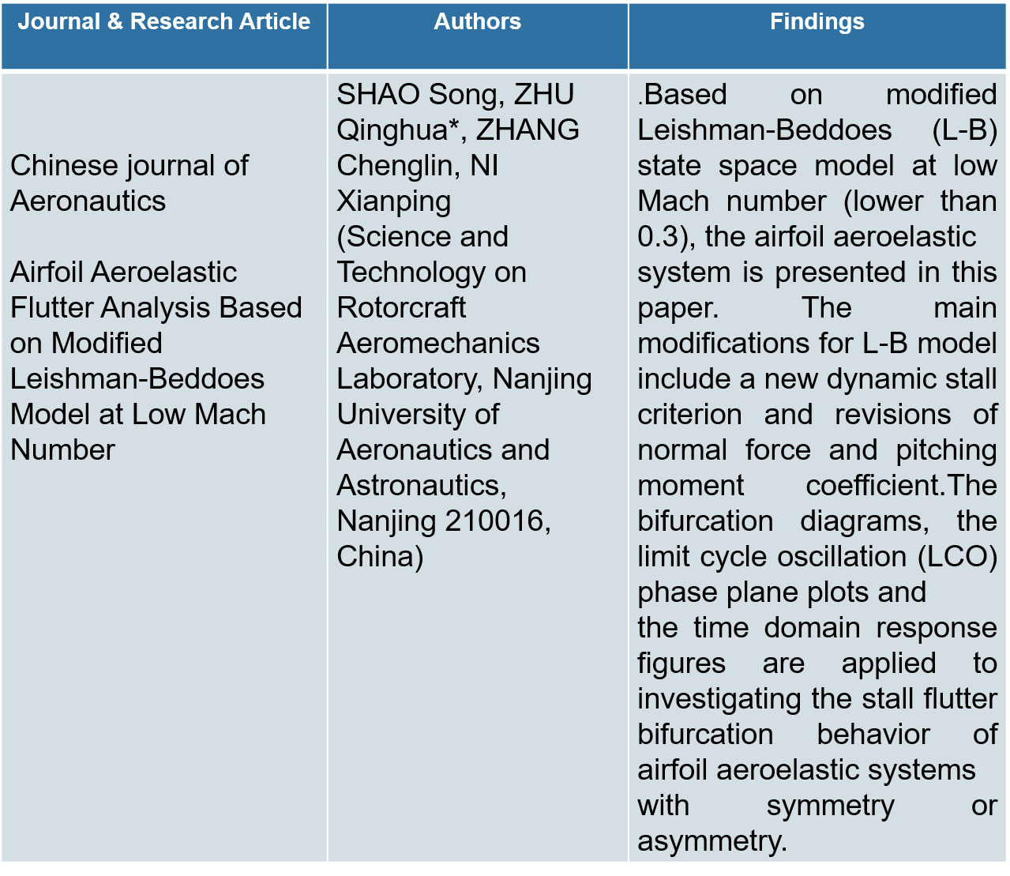
LITERATURE REVIEW:

Slide 6
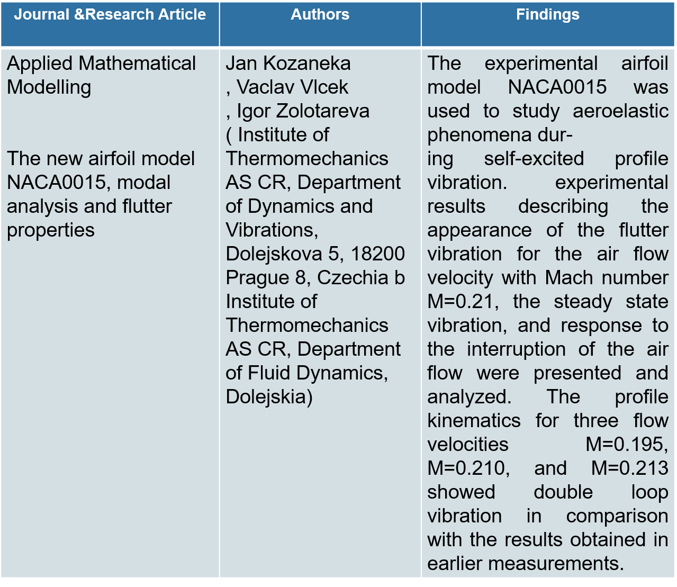

Slide 7
OBJECTIVE:
The objectives of the project on flutter analysis of airfoils are:
Accurately predict and mitigate potential flutter instabilities in airfoils.
Enhance aircraft safety by ensuring the structural integrity of airfoils under aerodynamic forces.
Optimize airfoil design parameters for improved aerodynamic performance and fuel efficiency.
Validate computational predictions through experimental testing and real-world validation.
Contribute to the advancement of flutter analysis techniques, providing reliable methods for the aviation industry to address flutter-related challenges.

Slide 8
Methodology:
The methodology for the project on flutter analysis of airfoils involves the following steps:
Literature Review: Conduct a comprehensive review of existing literature to understand the current state-of-the-art in flutter analysis, computational methods, experimental validation techniques, and optimization approaches.
Data Collection: Gather relevant data such as airfoil geometries, material properties, aerodynamic forces, and operating conditions. This data will serve as inputs for the computational analysis and validation.
Computational Analysis: Utilize advanced computational methods, such as computational fluid dynamics (CFD) and finite element analysis (FEA), to simulate the airflow around the airfoil and predict aerodynamic forces. Apply appropriate boundary conditions and numerical techniques to accurately model the flutter behavior.

Slide 9
Experimental Validation: Conduct experimental testing using wind tunnel studies or flight testing to validate the computational predictions. Compare the results from the computational analysis with the experimental data to ensure accuracy and reliability.
Optimization: Employ optimization techniques to optimize the airfoil design parameters, such as shape modifications or structural enhancements, to mitigate flutter risks and improve aerodynamic performance. Utilize multi-disciplinary design optimization approaches if necessary.
Analysis and Results: Analyze the computational and experimental results to evaluate the flutter behavior of the airfoil under different operating conditions. Identify potential flutter instabilities and assess the effectiveness of design modifications in mitigating flutter risks.
Documentation and Reporting: Document the methodology, findings, and conclusions of the flutter analysis project. Prepare reports and presentations summarizing the project's outcomes, including the validated computational models, optimized design parameters, and recommendations for enhancing aircraft safety and performance.

Slide 10
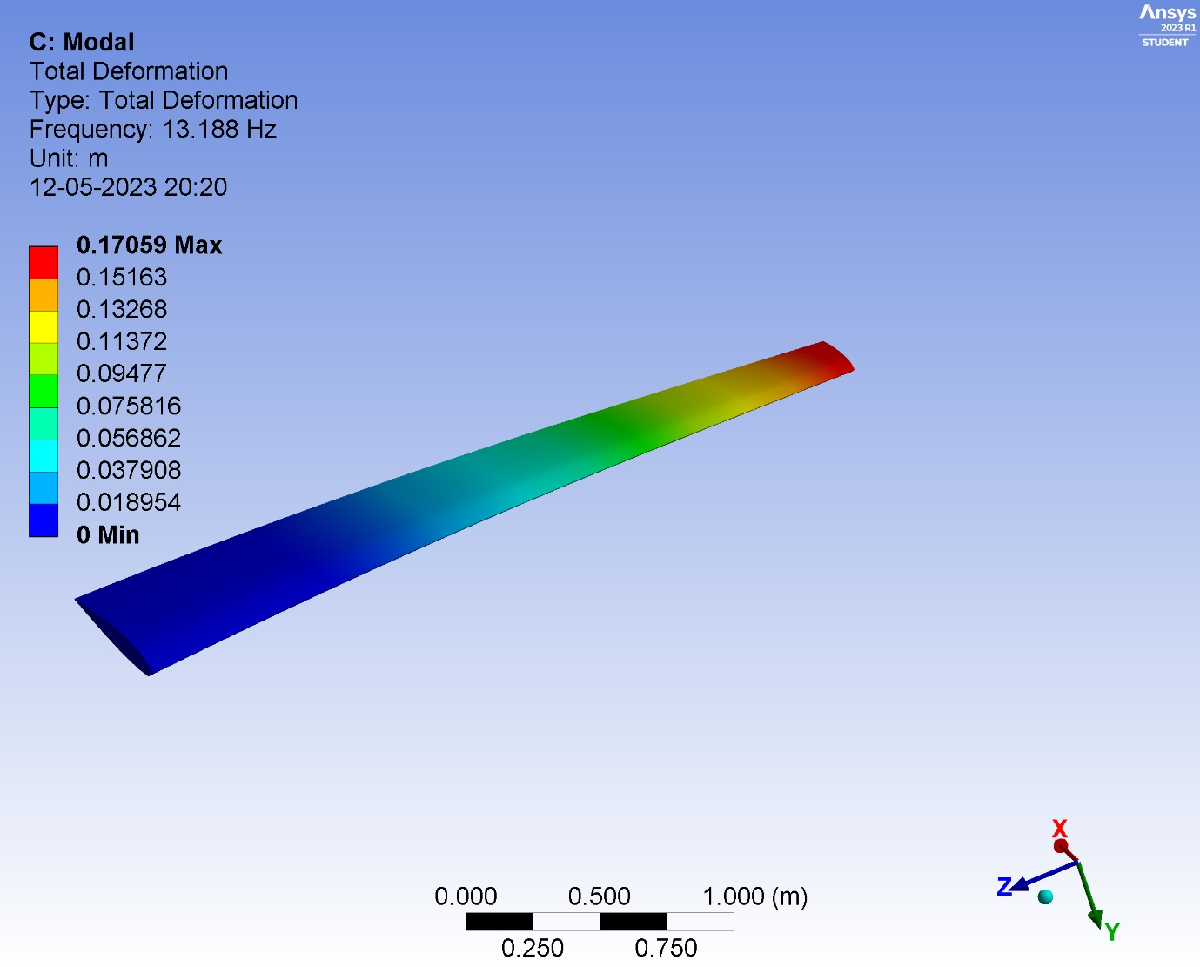
Results:

Slide 11
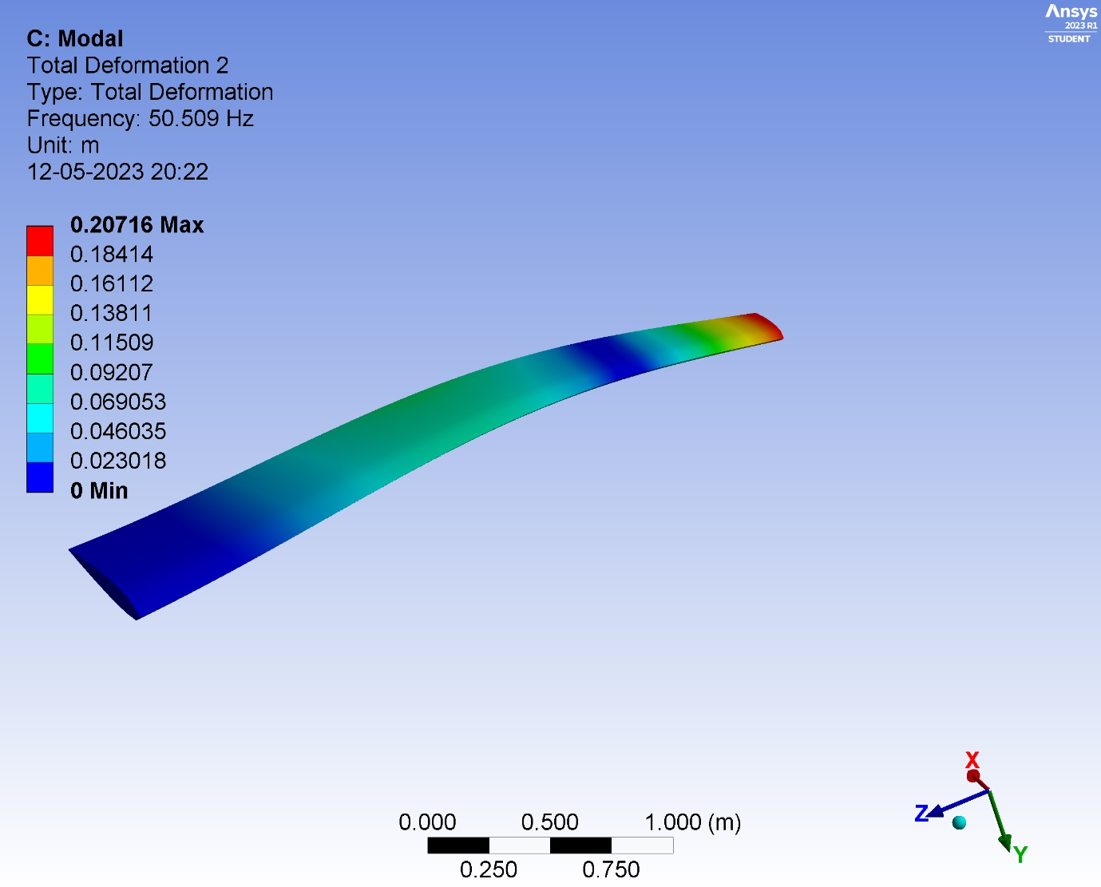

Slide 12
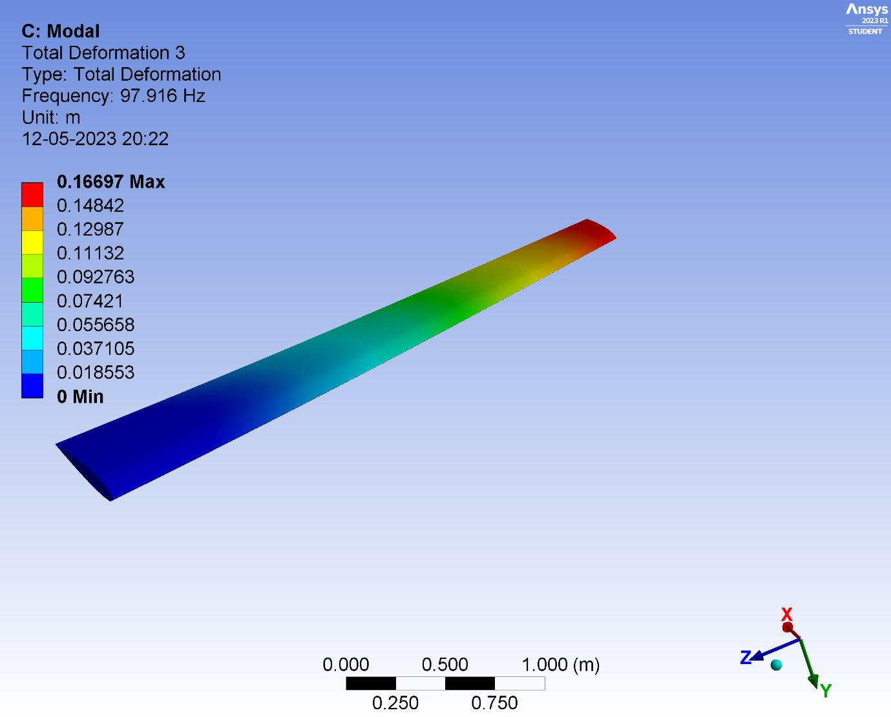

Slide 13
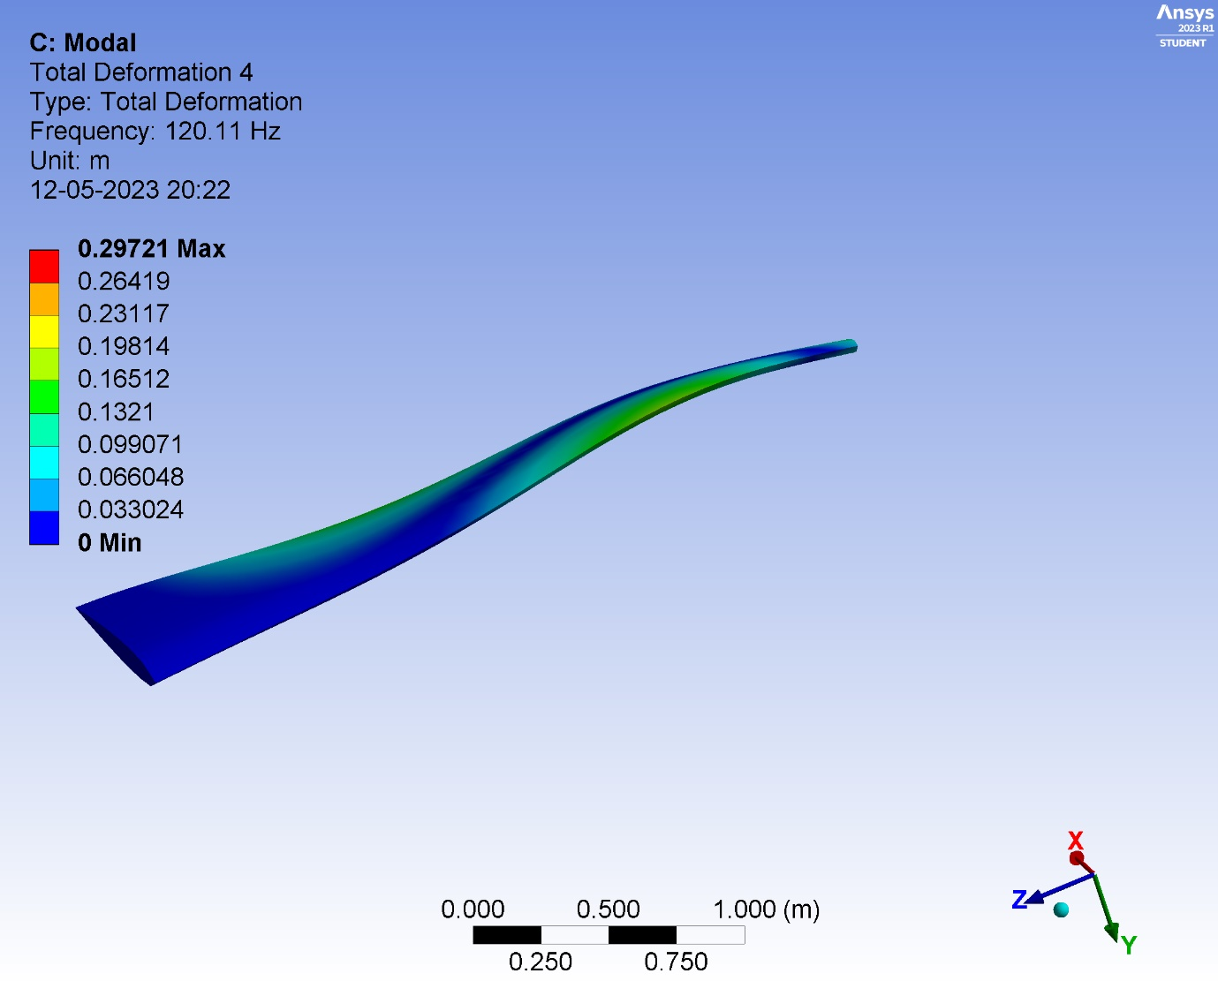

Slide 14
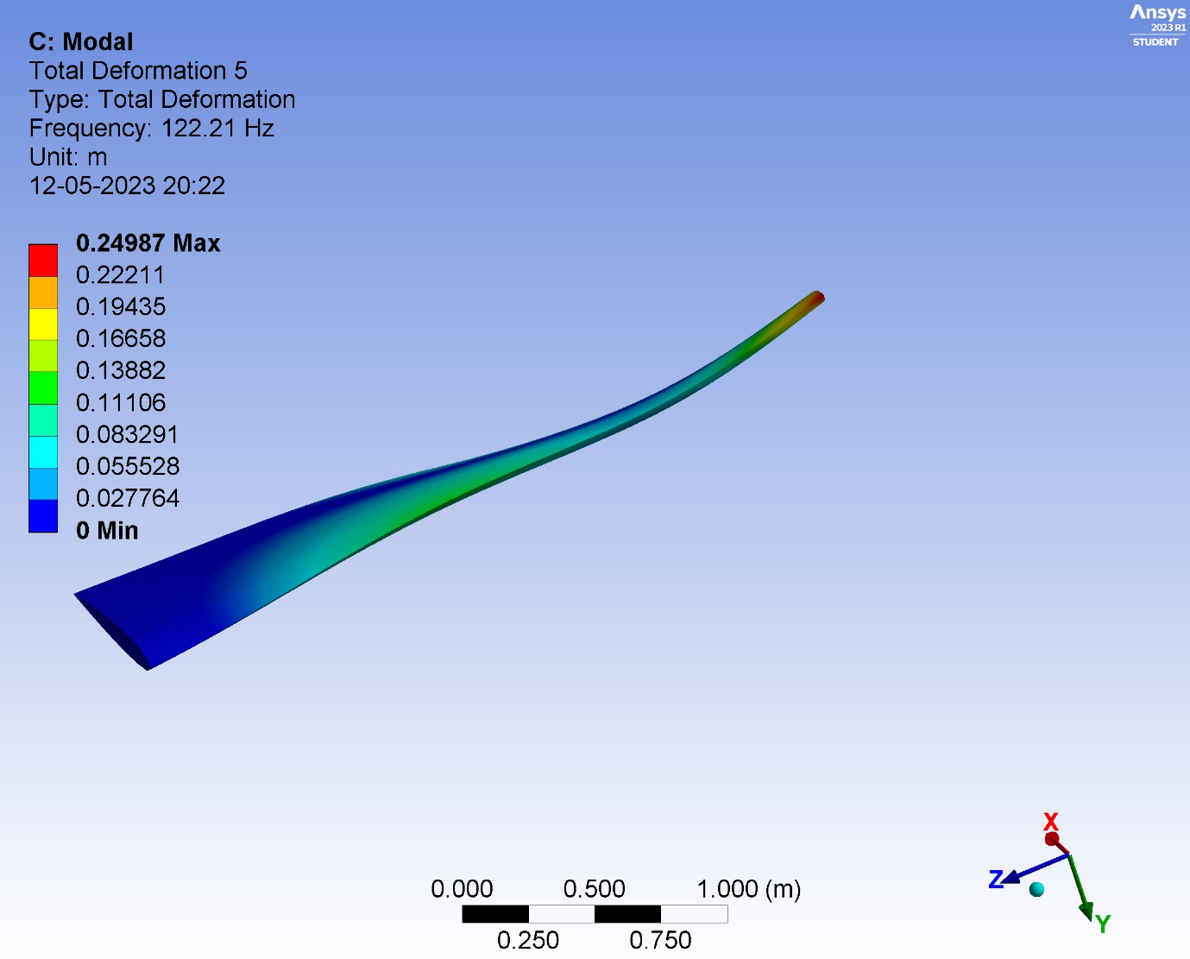

Slide 15
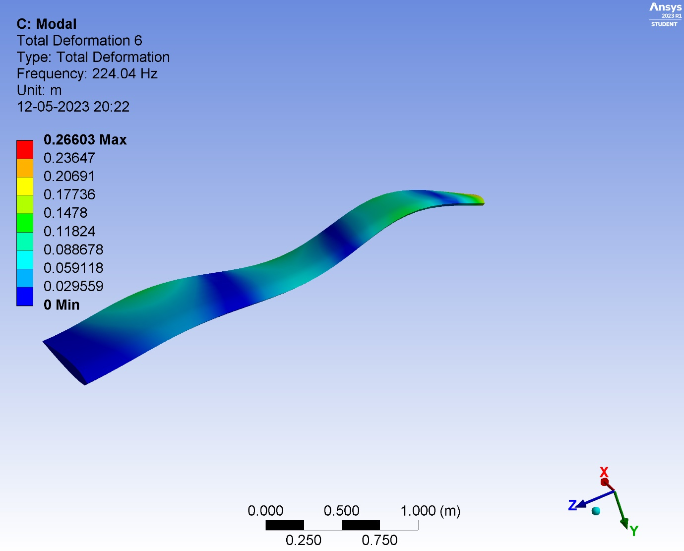

Slide 16
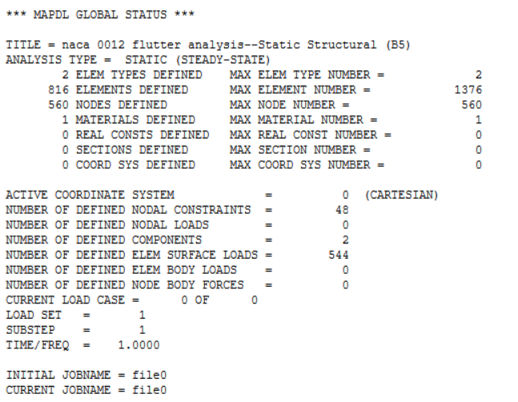
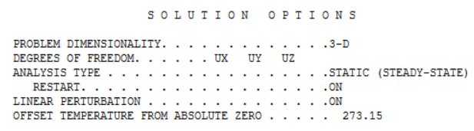

Slide 17
CONCLUSION:
In conclusion, the project on flutter analysis of airfoils has successfully addressed aircraft safety and performance concerns. By integrating advanced computational methods with experimental validation, accurate predictions and mitigation of flutter instabilities were achieved. Optimized airfoil designs led to improved aerodynamic performance and fuel efficiency. The project contributes to the body of knowledge in flutter analysis, emphasizing aeroelasticity, flutter suppression techniques, and compliance with industry standards. The methodology employed, including literature review, data collection, computational analysis, experimental validation, optimization, and result analysis, provided a robust framework. Documenting and reporting the outcomes offer valuable insights for the aviation industry, ensuring structural integrity and enhancing reliability and sustainability.

Slide 18
REFERENCE:
Jan KozanekaVaclav VlcekIgor ZolotarevaInstitute ofTheNACaeroeing s
Applied Mathematical ModellingThe new airfoil model NACA0015, modal analysis and flutter properties
SHAO Song, ZHUQinghua*, ZHANGChenglin, NI Xianping(Science and Technology on Rotorcraft Aeromechanics Laboratory, Nanjing University of Aeronautics and Astronautics, Nanjing 210016, China)
Chinese journal of AeronauticsAirfoil Aeroelastic Flutter Analysis Based on Modified Leishman-Beddoes Model at Low Mach Number

Slide 19
THANK YOU

